Slide 2
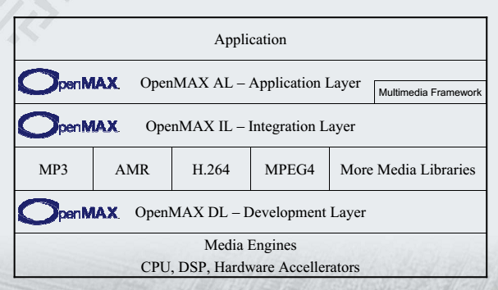

Slide 3
OpenMAX IL serves as a low-level interface for audio, video, and imaging codecs used in embedded and/or mobile devices
It gives applications and media frameworks the ability to interface with multimedia codecs and supporting components (i.e. sources and sinks) in a unified manner
The codecs themselves may be any combination of hardware or software and are completely transparent to the user. Without a standardized interface of this nature, codec vendors must write to proprietary or closed interfaces to integrate into mobile devices

Slide 4
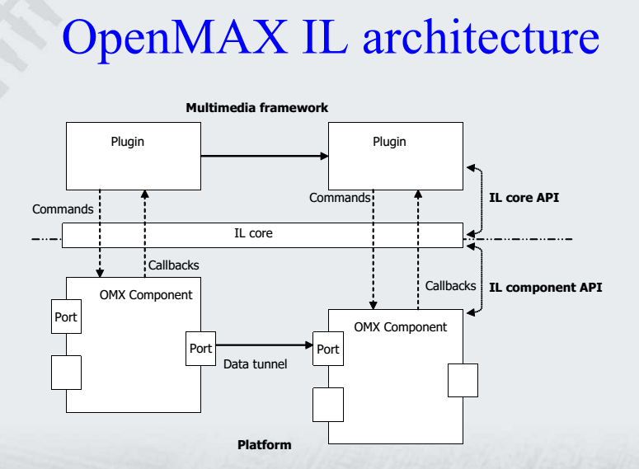

Slide 5
OpenMAX IL Core
Provides the functions to build and destroy each component
It gives all the information functionalities needed
– List of components
– List of capabilities (roles) where supported
It tries to set up the direct connection between two components

Slide 6
IL Core functions
OMX_Init, OMX_Deinit: inintialize and de-initialize the core environment.
OMX_ComponentNameEnum, OMX_GetComponentsOfRole, OMX_GetRolesOfComponent:
these functions provide information about the components available in the system, the components that support a specific role and the rolessupported by a given component (see later for role definition)

Slide 7
OMX_GetHandle, OMX_FreeHandle: these functions are used to create and destroy an instance of a given component
OMX_SetupTunnel: This function tries to establish a tunnel between two ports of two components.

Slide 8
IL Components
An OpenMAX IL component is a black box that receives instruction with asynchronous commands and transmit/receive data through ports
• It is uniquely identified by a string name, like the following
“OMX.vendor_name.component_name”
• A component is base profile compliant if it supports the standard and buffer are exchanged only with an IL client
• A component is interop profile compliant if it supports the base profile and is able to setup the tunneling with other interop components

Slide 9
IL Component ports
The data is transferred to/from IL client and between components through ports
• Any port contains the information about any
buffer needed, the minimum size of them, and
any other implementation specific need
• Any buffer used in a port should be registered on it using the functions UseBuffer/AllocateBuffer during the setup phase of the component (Loaded state)

Slide 10
Android Extension on OMX
OMX.google.android.index.enableAndroidNativeBuffers
OMX.google.android.index.storeMetaDataInBuffers
OMX.google.android.index.useAndroidNativeBuffer
OMX.google.android.index.getAndroidNativeBufferUsage

Slide 11
OMX_Core.h
Core API
OMX_Component.h
API related to Component

Slide 12
libstagefright_omx
OMX
OMXMaster
libstagefrighthw.so
SoftOMXPlugin
libstagefright_soft_xxx

Slide 13
What OMX provides
allocateNode
sendCommand
enableGraphicBuffers
storeMetaDataInBuffers
useBuffer
allocateBuffer
freeBuffer
emptyBuffer

Slide 15
Reference
http://quandarypeak.com/2013/08/androids-stagefright-media-player-architecture/
http://elinux.org/images/5/52/Elc2011_garcia.pdf
https://community.freescale.com/servlet/JiveServlet/downloadBody/93611-102-4-3711/Multimedia%20with%20VPU%26IPU%20HW%20acceleration%20in%20Android.pptx
https://gforge.ti.com/gf/download/frsrelease/248/3093/OMAPZoom_Android_Multimedia.ppt
http://elinux.org/images/e/e0/The_OpenMAX_Integration_Layer_standard.pdf

